Slide 1
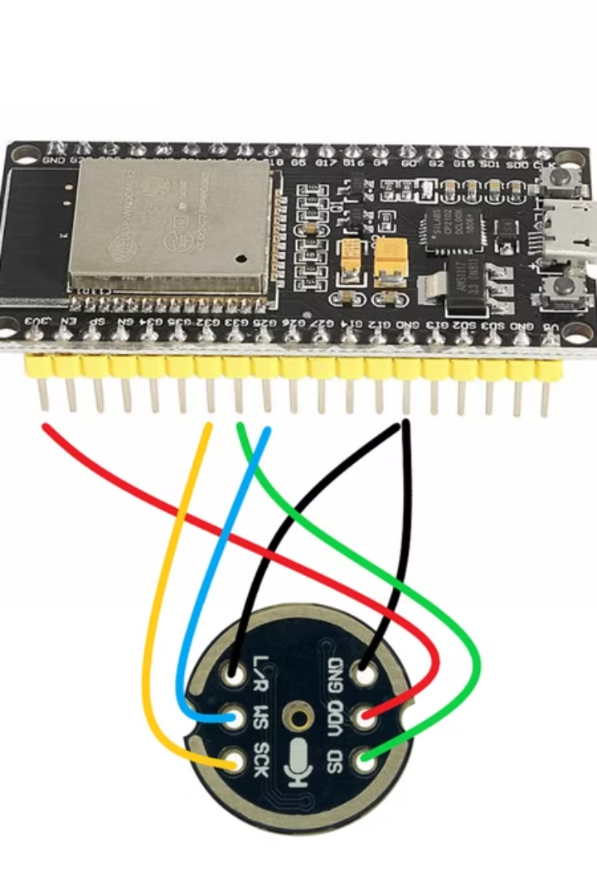
ESP32-Based Multilingual Classroom Assistant
This explores a revolutionary concept – an ESP32-powered system that facilitates multilingual communication in classrooms. Imagine a future where language barriers cease to exist, enabling teachers to reach diverse students effectively.

Slide 2

The Teacher's Perspective
ESP32 as the Hub
One-to-Many Communication
The teacher's ESP32 is equipped with a high-quality microphone for capturing clear audio. It also functions as a wireless communication hub, relaying speech to student devices via Wi-Fi or Bluetooth.
Using ESP-NOW, the teacher's device can broadcast audio to multiple student devices simultaneously, creating a dynamic and inclusive learning environment.

Slide 3
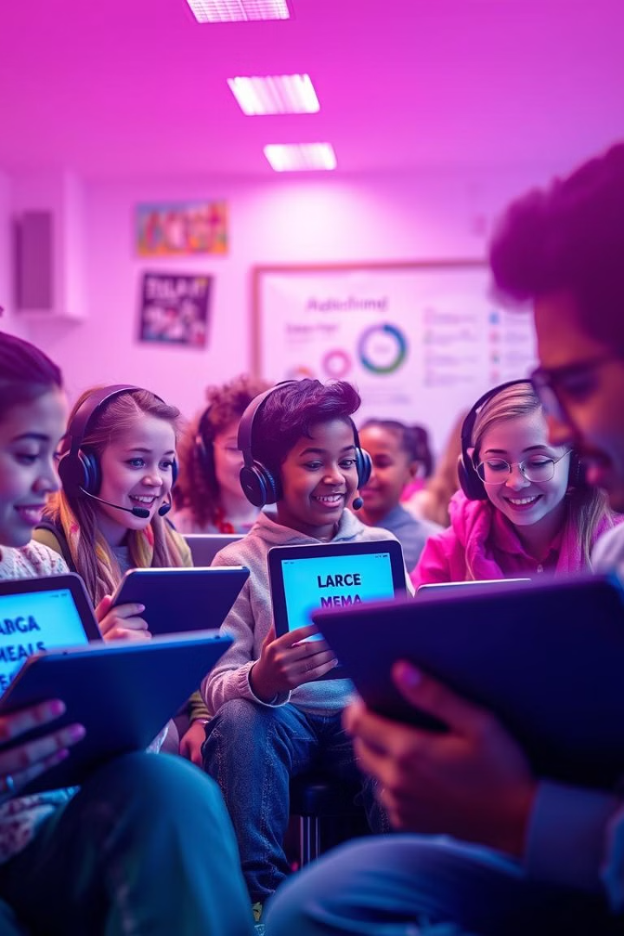
The Student's Experience
Bluetooth Communication
Seamless Translation
The student's ESP32 processes the incoming audio using cloud-based speech recognition and translation services, ensuring accuracy and real-time delivery.
Each student uses an ESP32 connected to a Bluetooth headset, allowing for personalized audio playback of translated speech in their native language.

Slide 4
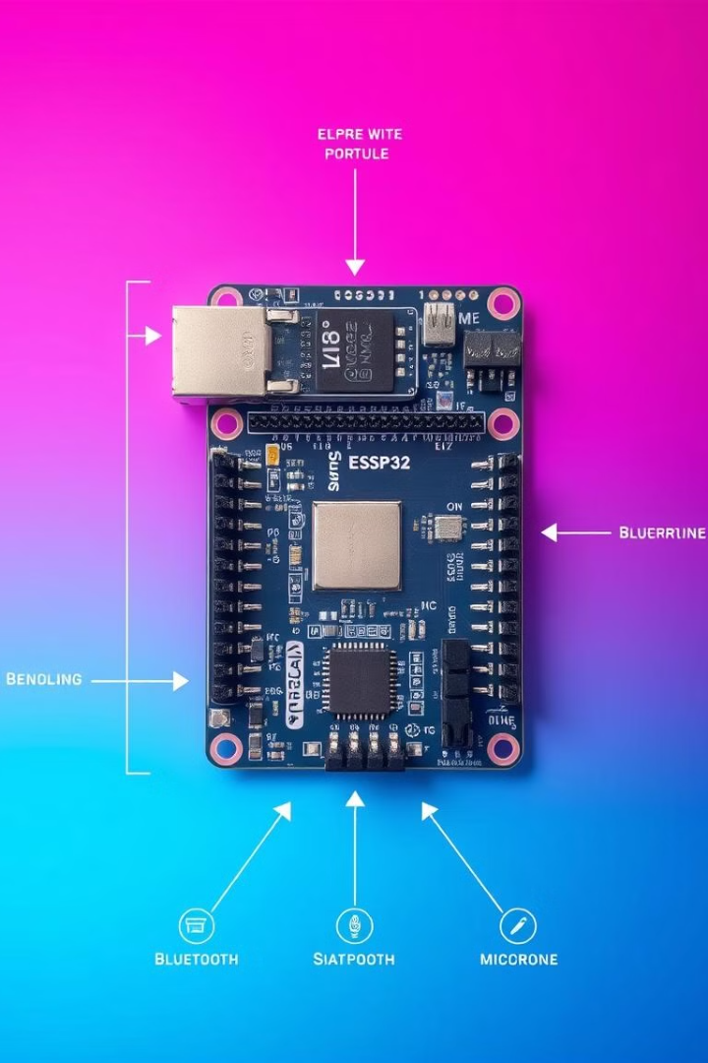
Hardware and Software Components
1
ESP32 Development Board
2
High-Quality Microphone
This versatile microcontroller serves as the core of the system, managing audio capture, processing, and communication.
An I2S MEMS microphone, such as SPH0645LM4H, ensures clear and accurate audio capture for optimal speech recognition.
3
Bluetooth Module
A Bluetooth module enables wireless communication between the ESP32 and the student's Bluetooth headsets for seamless audio transmission.

Slide 5



Key Technical Aspects
Speech Recognition (STT)
1
The captured audio is converted into text using cloud-based services (e.g., Google Speech-to-Text) or offline models (e.g., Vosk) for accurate transcription.
Translation
2
The transcribed text is translated into the student's language using advanced translation APIs (e.g., Google Translate) for precise and context-aware results.
Text-to-Speech (TTS)
3
The translated text is converted back into speech using cloud-based TTS engines (e.g., Google Cloud Text-to-Speech) to create natural-sounding audio for playback.

Slide 6
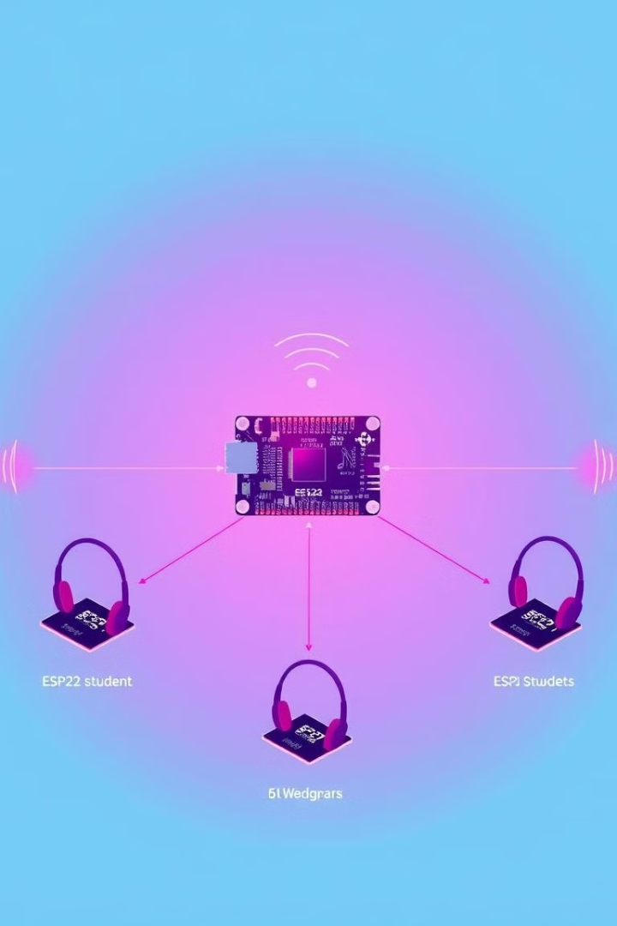
Networking and Communication
ESP-NOW
Wi-Fi and Bluetooth
ESP-NOW allows for direct, peer-to-peer communication between ESP32 devices, enabling efficient broadcast of audio to multiple student devices within a cluster.
Wi-Fi is used for communication between clusters, while Bluetooth is employed for personalized audio playback to each student's headset.

Slide 7

Addressing Challenges
Latency
Accuracy
Real-time translation requires low latency. This is achieved through efficient network protocols, audio compression, and buffering strategies.
High-quality microphones, noise cancellation, and advanced speech recognition algorithms are crucial for accurate transcription of speech.
Synchronization
The system ensures that the translated speech aligns with the teacher's speech by using timestamps, frame-based synchronization, and buffering techniques.

Slide 8
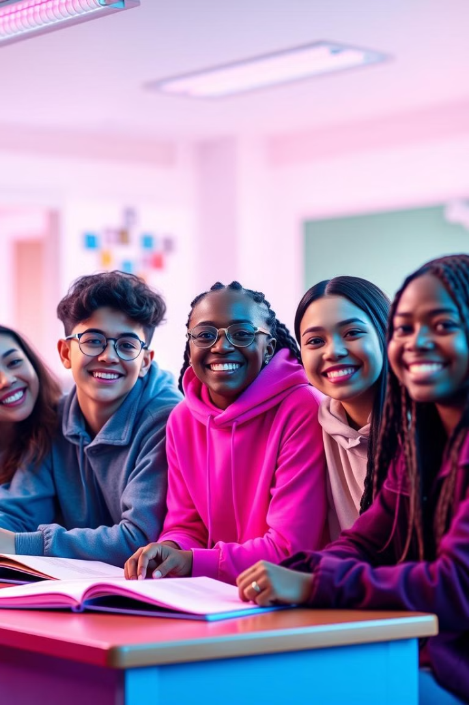



Benefits and Impact
Global Accessibility
Enhanced Connection
This system empowers teachers to reach a global audience, breaking down language barriers and fostering an inclusive learning environment for all.
Direct communication in the student's native language fosters a stronger connection between teachers and students, leading to more personalized learning experiences.
Efficient Management
This technology streamlines classroom management, enabling teachers to effectively engage and guide diverse learners, ultimately improving classroom efficiency and effectiveness.

Slide 9
The Future of Multilingual Learning
Personalized Learning
1
The system can be tailored to individual student needs, offering personalized learning experiences based on their language proficiency and learning style.
Adaptive Translation
2
Future advancements may include AI-powered adaptive translation that considers context, domain-specific terminology, and individual student preferences.
Augmented Reality
3
Integration with augmented reality (AR) can create immersive and interactive learning experiences, making the learning process more engaging and memorable.

Slide 10
GITHUB LINK:
https://github.com/deepak75500/vit_hackathon

Slide 11

Conclusion: Shaping the Future of Education
The ESP32-based multilingual classroom assistant represents a groundbreaking step toward more inclusive and effective education. It empowers teachers to reach diverse learners, fosters global accessibility, and paves the way for a future of personalized and dynamic learning experiences.

